Slide 1
Insurance policy data analysis
& insights
TOOLS USED
Excel
MySql
Power Bi
Tableau
PRESENTED BY-
Lav Dubey

Slide 2
agenda
Introduction
KPI Analysis
Policy & Customer Analysis
Key Findings / Business Insights
Recommendations
Dashboards
MySql Queries
Conclusion

Slide 3
introduction
Analysed insurance policy data to understand overall business performance.
Studied policy distribution, customer behaviour, claims, payments, and premium trends.
Developed key KPIs and visualizations to identify important patterns in the data.
Used Excel and MySQL for data analysis and validation.
Used Power BI and Tableau to create interactive dashboards and visual reports.
Identified key business insights and opportunities for improvement.
Provided data-driven recommendations to support better business decisions.

Slide 4
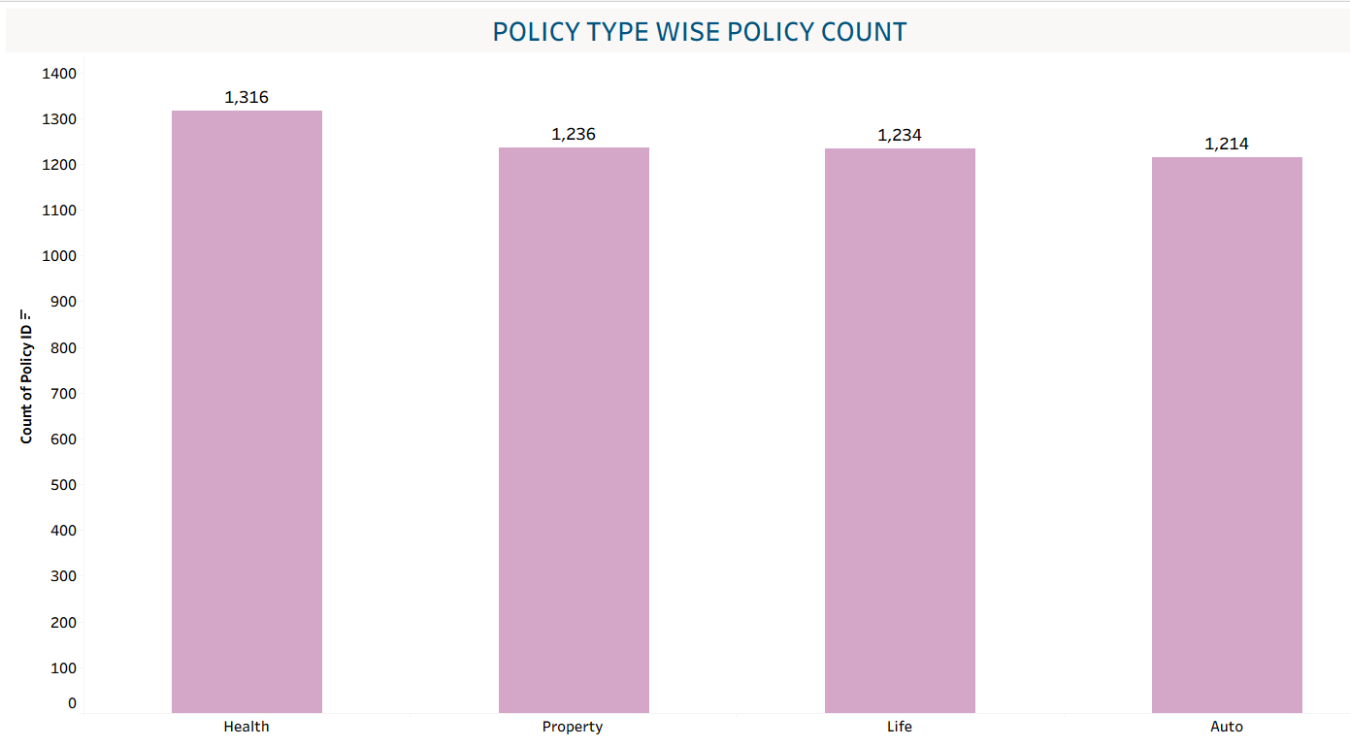
Kpi-1 : POLICY TYPE WISE POLICY COUNT
The analysis shows that Health Insurance has the highest number of policies sold, with 1,316 policies.
This is followed by Property Insurance (1,236), Life Insurance (1,234), and Auto Insurance (1,214).
The company is performing relatively well in the Health Insurance segment.
However, there is an opportunity to improve sales in the other three segments, particularly Auto Insurance, which has the lowest number of policies sold.
The company should focus on increasing sales of Auto, Property, and Life Insurance while maintaining its strong performance in the Health Insurance segment.

Slide 5
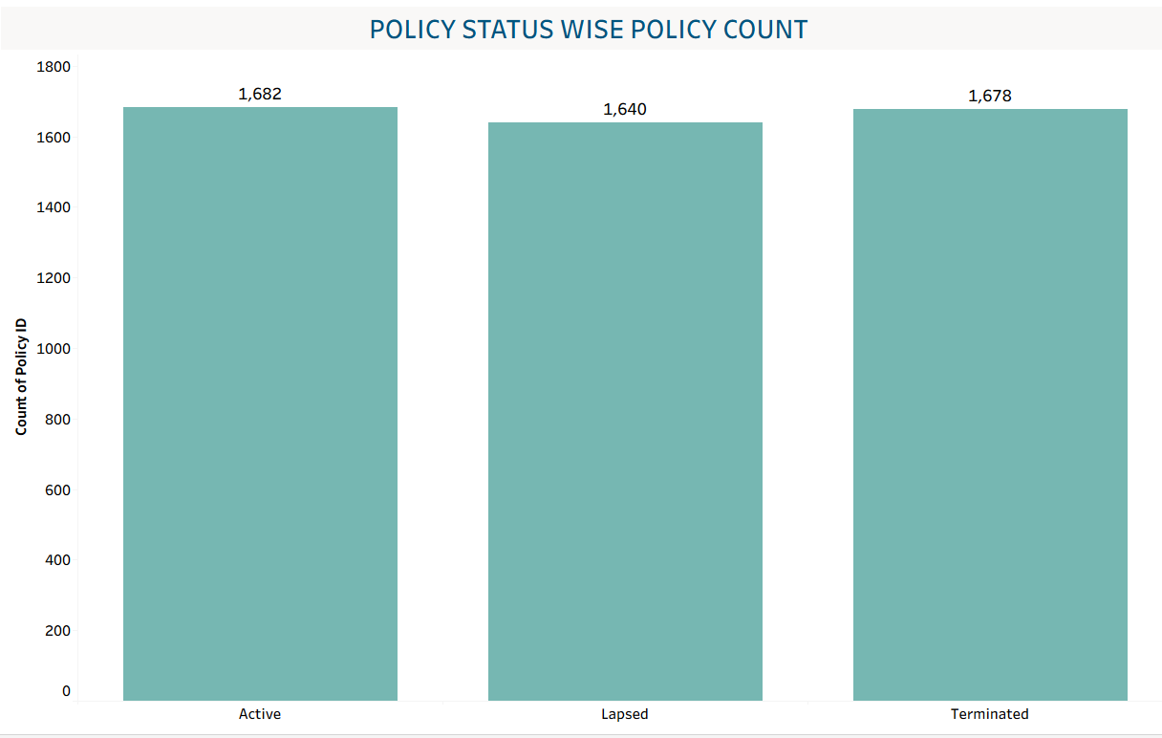
Kpi-2 : POLICY STATUS WISE POLICY COUNT
The analysis shows that 1,682 policies are currently active, which is a positive indicator for the company.
However, 1,640 policies are lapsed, which is a significant concern and represents a major opportunity for improvement.
The company should focus on policy renewals and reactivation strategies to bring as many lapsed policies back into the active category as possible.
A significant number of policies have also been terminated, highlighting the need to strengthen customer retention and understand the key reasons behind policy termination.
Alongside renewal and retention efforts, the company should focus on acquiring new customers and selling new policies to compensate for terminated policies and support overall revenue growth.

Slide 6
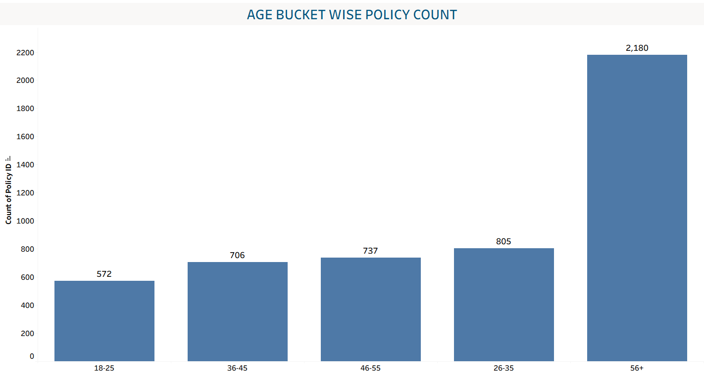
Kpi-3 : age bucket – wise policy count
Customers aged 56+ hold the highest number of policies, making them a highly valuable customer segment.
The company should focus on building strong, long-term relationships with this segment and retaining them.
Customers aged 46–55 should also be targeted, as they are approaching the 56+ segment and represent a strong future customer base.
The company should also focus on the 18–25 age group by offering attractive plans, benefits, or incentives that encourage them to start investing in insurance early.
This approach can help the company retain valuable customers, build future customer relationships, and increase overall policy sales.

Slide 7
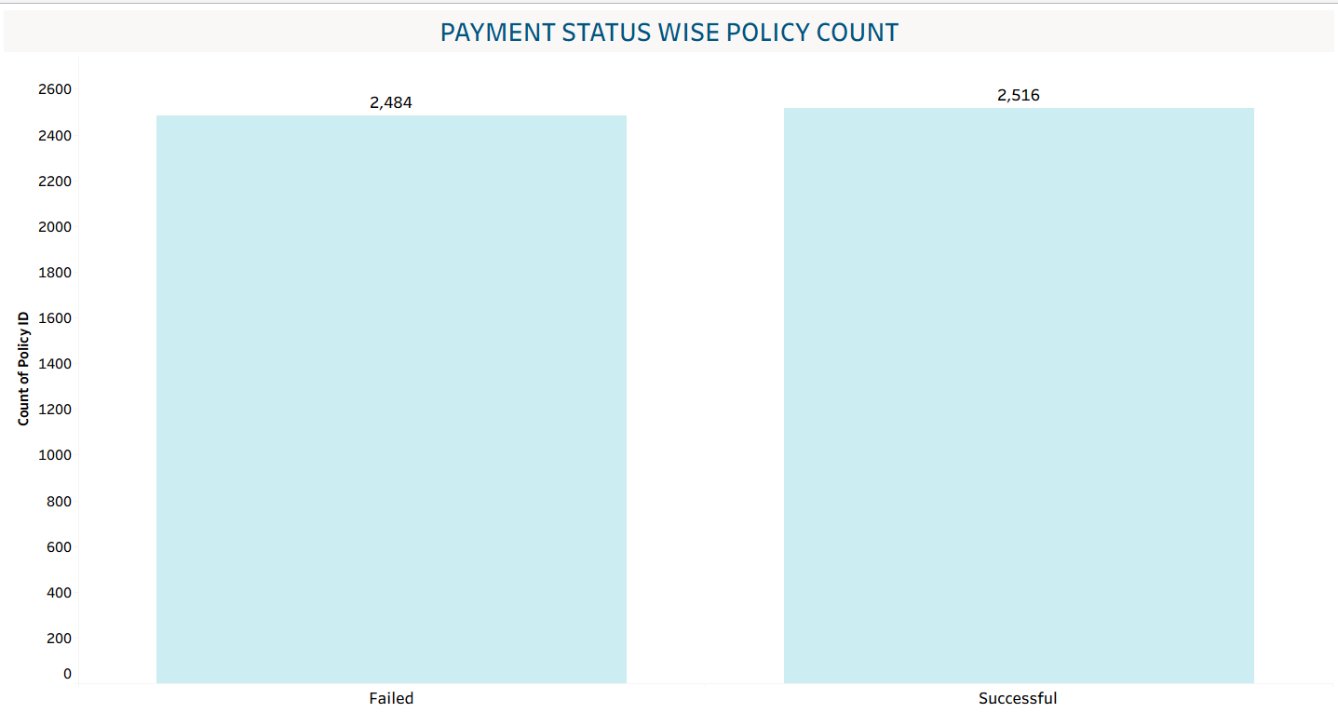
Kpi-4 : payment status wise policy count
The analysis highlights payment failures as a major concern, with 2,484 failed payments compared with 2,516 successful payments.
Although the number of successful payments is slightly higher, the volume of failed payments is still significantly high and could directly impact the company’s revenue and customer retention.
The company should investigate the root causes of these payment failures, such as payment gateway issues, transaction errors, or customer-related factors.
Identifying and resolving these issues should be a high priority to reduce failed transactions, improve the payment success rate, and minimize potential revenue loss.

Slide 8
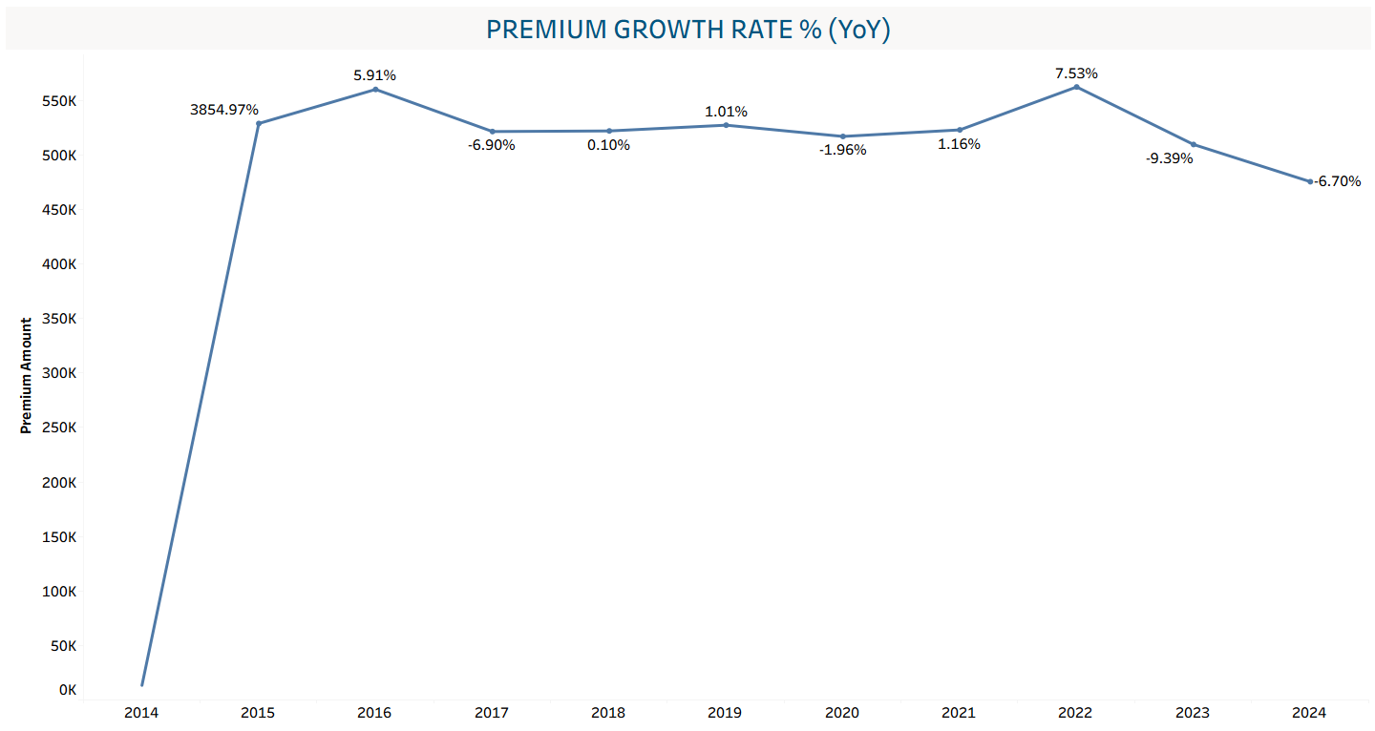
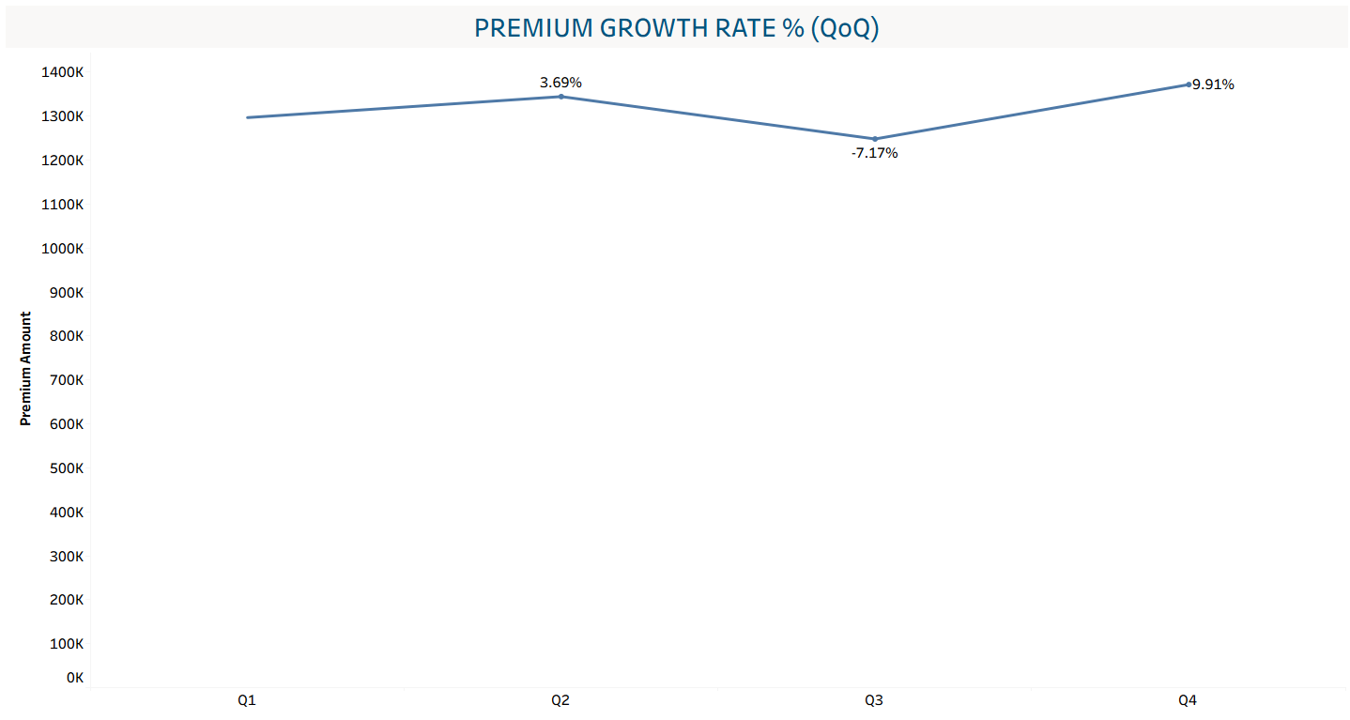
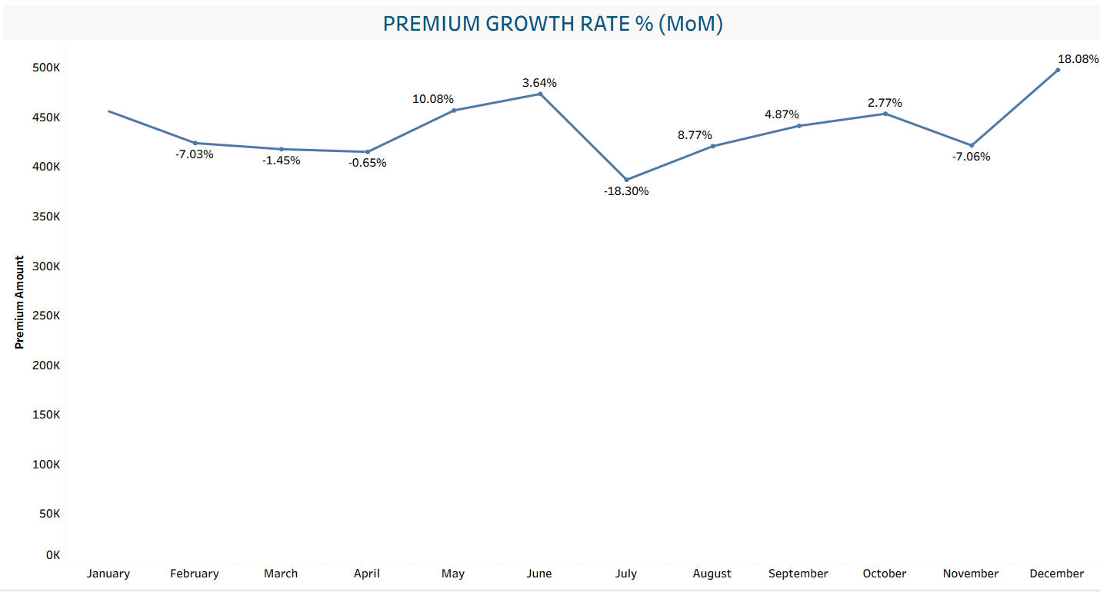
Kpi-5 : YOy / mom / qoq premium performance
YoY analysis shows a recent decline, with premium decreasing by 9.39% in 2023 and 6.70% in 2024.
Overall, the YoY trend indicates a recent decline in premium growth, highlighting the need to identify the underlying factors and take corrective actions to improve future performance.
Premium performance shows considerable volatility across monthly and quarterly periods.
MoM growth peaked at 18.08% in December, while July recorded the sharpest decline of 18.30%.
QoQ performance recovered strongly in Q4 with 9.91% growth after a 7.17% decline in Q3.
This analysis is highlighting the need to investigate the factors affecting premium growth.

Slide 9
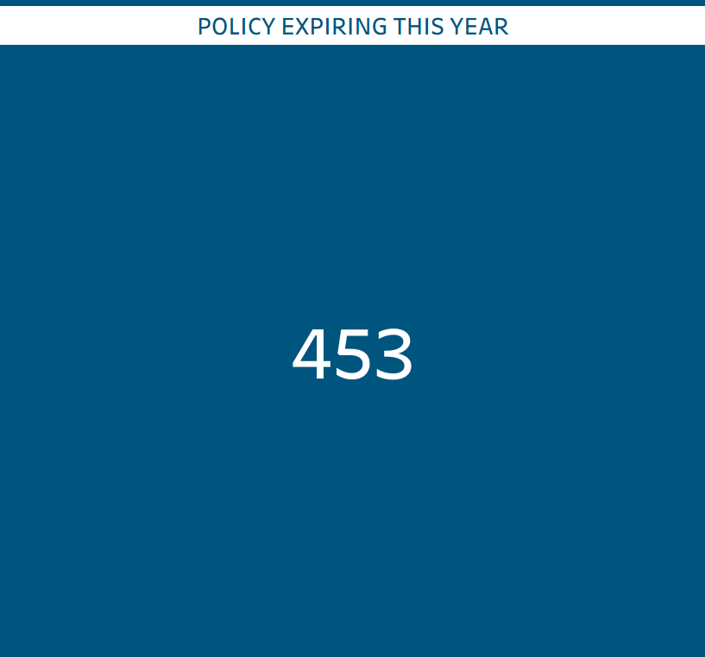
Kpi-6 : policies expiring this year
This KPI highlights the number of policies that are scheduled to expire during the current year.
This presents a valuable opportunity for the company, as there is still sufficient time to proactively approach these customers and encourage policy renewals.
The company should prioritize these policies and ensure that potential renewals are not lost.
The renewal team should take proactive action, engage with customers well before their expiry dates, and maximize the policy renewal rate.

Slide 10
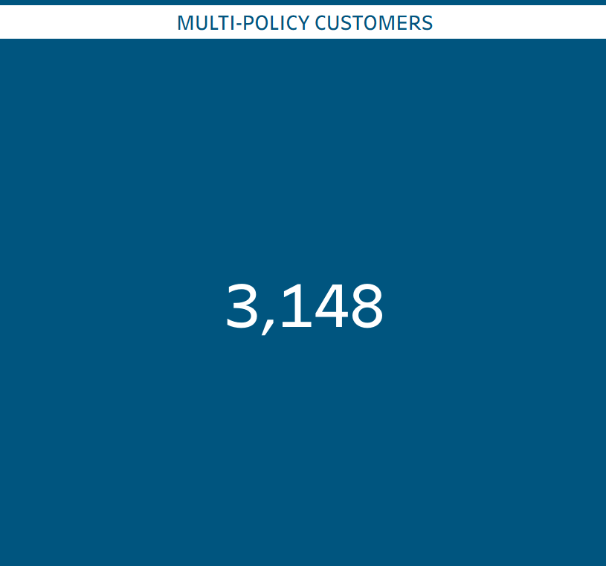
Kpi-7 : Customers holding multiple policies
The analysis shows that 3,148 customers hold multiple policies, making them a highly valuable and loyal customer segment.
Since these customers already demonstrate a strong level of trust and engagement with the company, they represent a significant opportunity for cross-selling and upselling.
The company can introduce personalized offers, discounts, loyalty benefits, or bundled policies to encourage these customers to purchase additional products.
Focusing on this segment can help the company strengthen customer relationships, increase policy sales, and generate additional revenue.

Slide 11

recommendations
After analysing the data, several areas stand out as opportunities for improving the company's performance and revenue:
Focus on Expiring Policies – Proactively contact customers whose policies are expiring this year and encourage timely renewals to prevent customer and revenue loss.
Reduce Failed Payments – The high number of failed payments is a major concern. The company should identify the root causes and improve the payment process to increase the successful payment rate.
Reactivate Inactive/Lapsed Policies – The company should strengthen its renewal and retention efforts by offering suitable discounts, incentives, or personalized plans to bring inactive policies back into the active category.
Target Younger Customers – The company should focus more on younger customers by offering affordable and attractive insurance plans. Building relationships with them early can create a long-term customer base.
Improve YoY Growth – The company's weak YoY performance indicates a need to improve both customer retention and new policy acquisition. Implementing the above strategies can contribute to stronger year-over-year growth.
Improve Claim Settlement Experience – Only 1,712 claims are approved, which may indicate an area requiring attention. A low approval rate or slow claim experience could negatively affect customer trust and discourage potential customers from purchasing policies. The company should investigate the reasons behind rejected claims and improve the overall claims process.

Slide 12
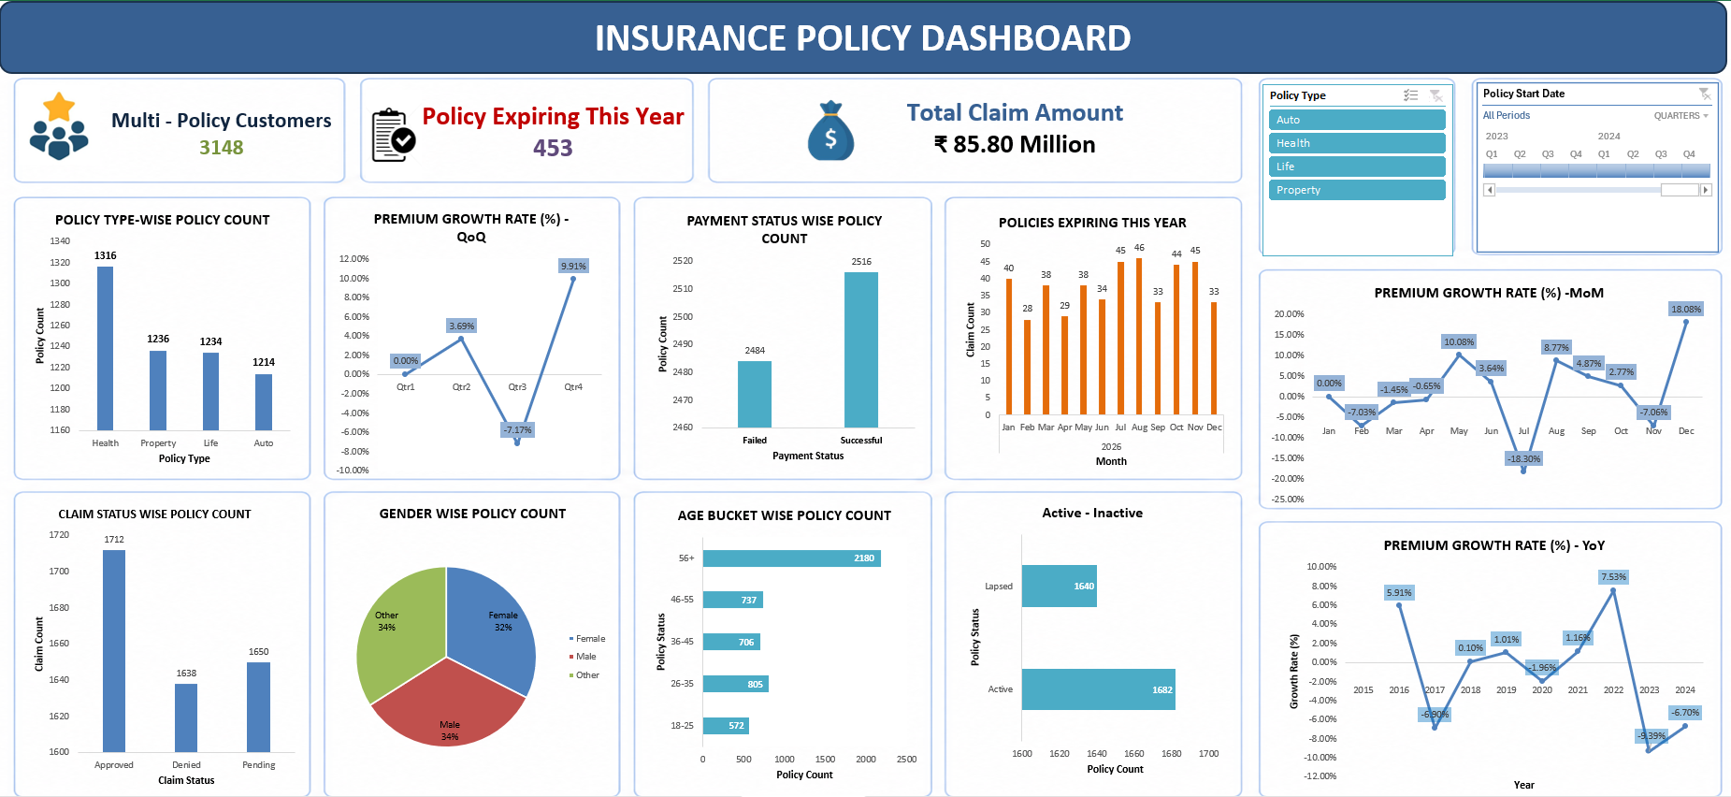
Excel dashboard

Slide 13
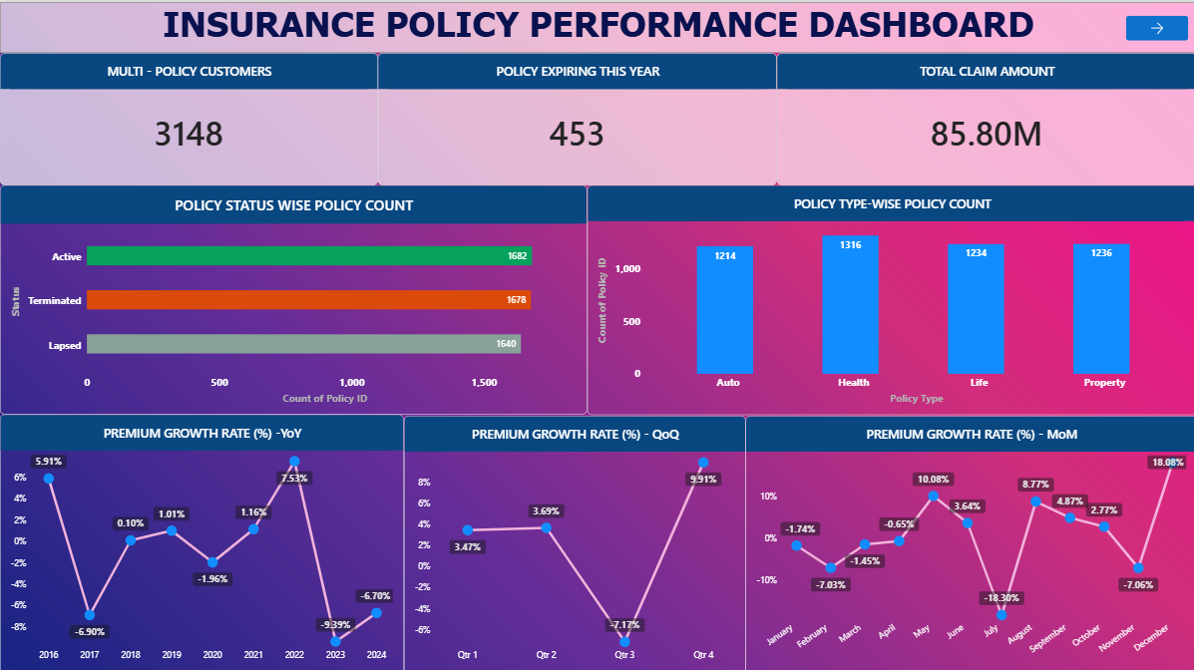
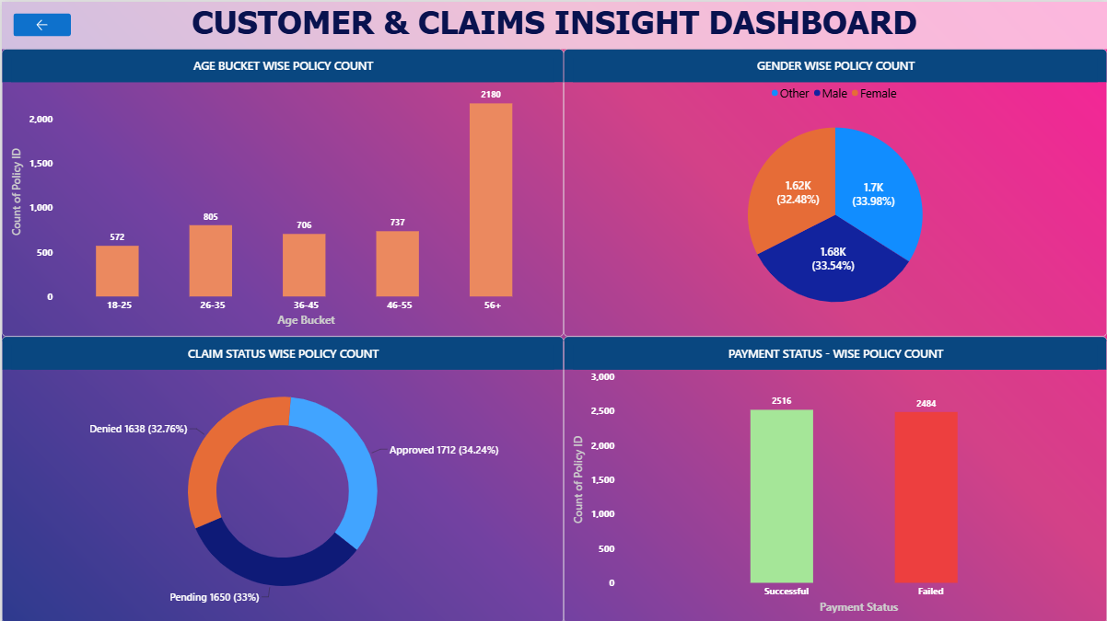
Power bi dashboard

Slide 14
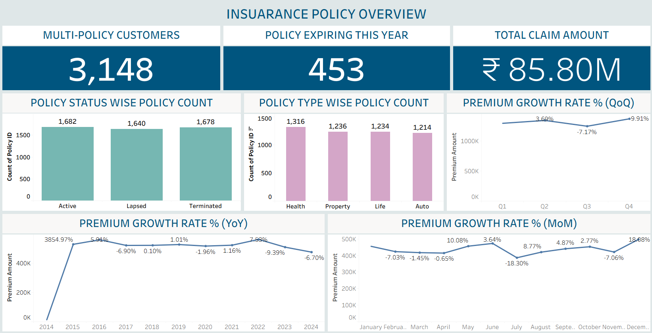
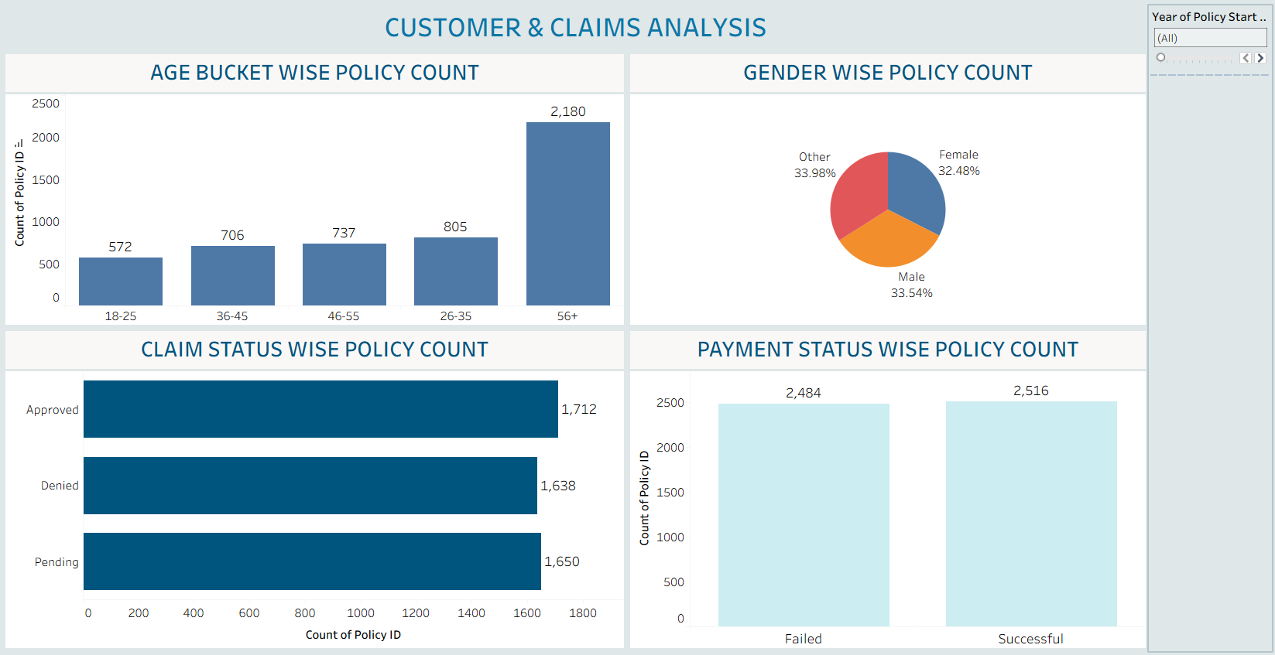
tableau dashboard

Slide 15
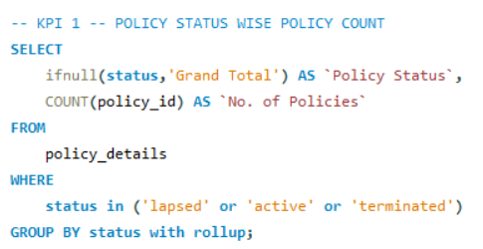
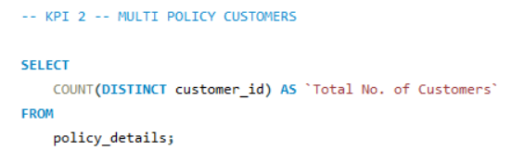
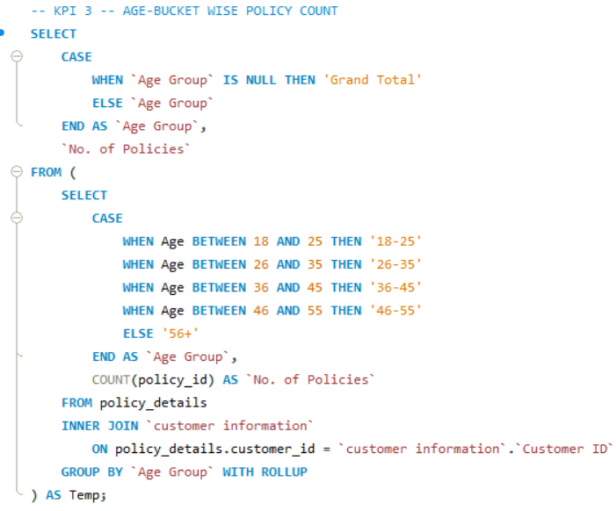
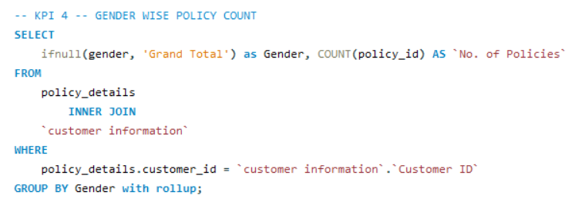
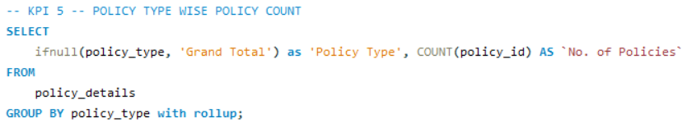
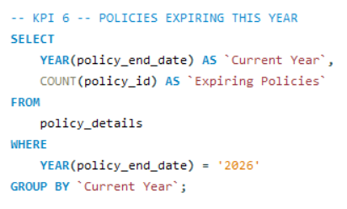
Mysql queries

Slide 16
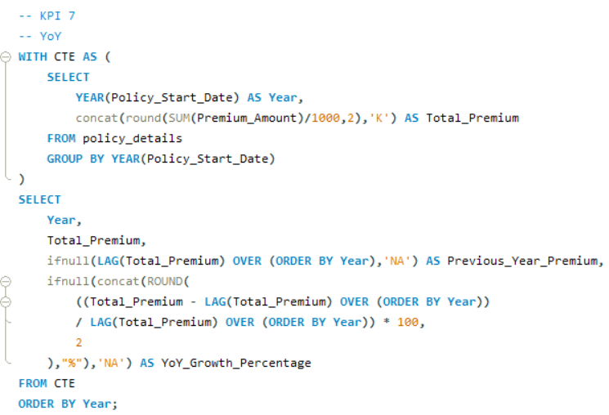
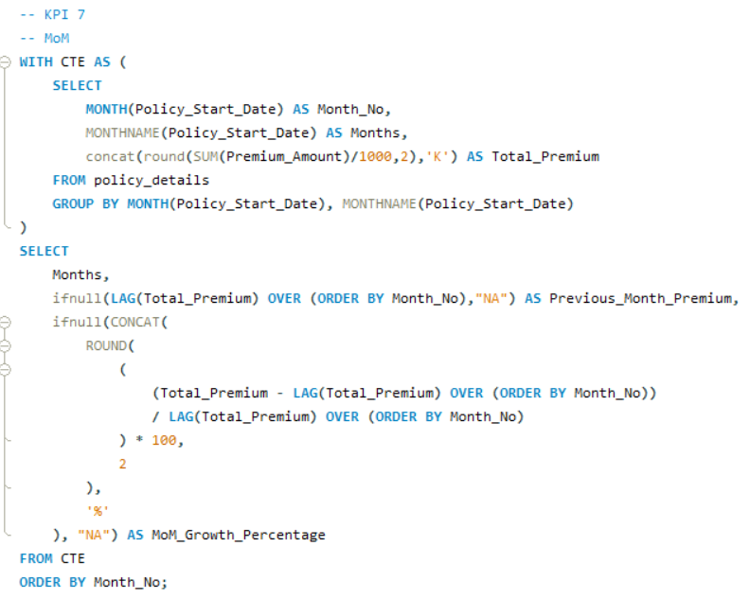
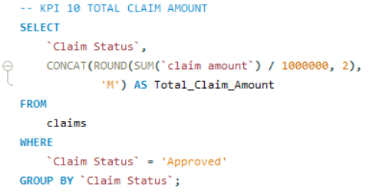
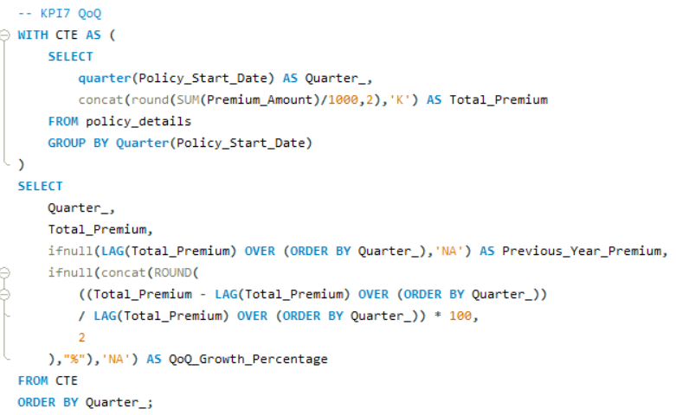
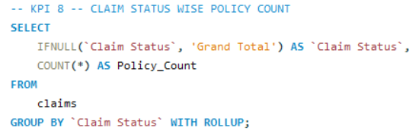
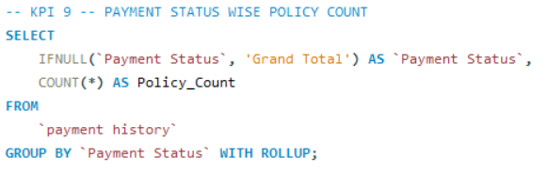
Mysql queries

Slide 17
conclusion
The analysis identified key challenges in retention, payments, claims, and YoY growth, while also revealing strong opportunities in renewals, policy reactivation, cross-selling, and younger-customer acquisition. By addressing these areas with targeted, data-driven strategies, the company can improve customer retention, increase revenue, and achieve sustainable business growth.

Slide 18
Thank you

